Slide 1
Exploring relationships between force plate and injury Data
Parker Booth & Beverly Albert

Slide 2



The goal is to turn data into information, and information into knowledge that guides decision-making.
Notes:
We collect large amounts of data within our setting. The goal is to identify what information is knowledge that could assist decision-making.
The aim of our project is to explore how to do this using CMJ forceplate data and injury reports across our teams, with the goal of better understanding how to mitigate maladaptive coping and injury events.

Slide 3
Soft tissue Injuries & Incidence
Injuries to the muscles, tendons, and ligaments
Contusions, sprains, tendonitis, strains
trauma, overload, and overuse¹⁰
Severity related to time between initial event and full participation⁵
Lower body STI injuries account for 47 to 89.6 percent¹¹
Notes:
STI are damage to muscles, tendons, and ligaments due to stress that exceeds what those structures can tolerate. Although varying between sports, lower body STI have high incidences across all levels of sports. Due to it's relevance and ability to evaluate risk in our athletes, our project focused on these injuries.

Slide 4
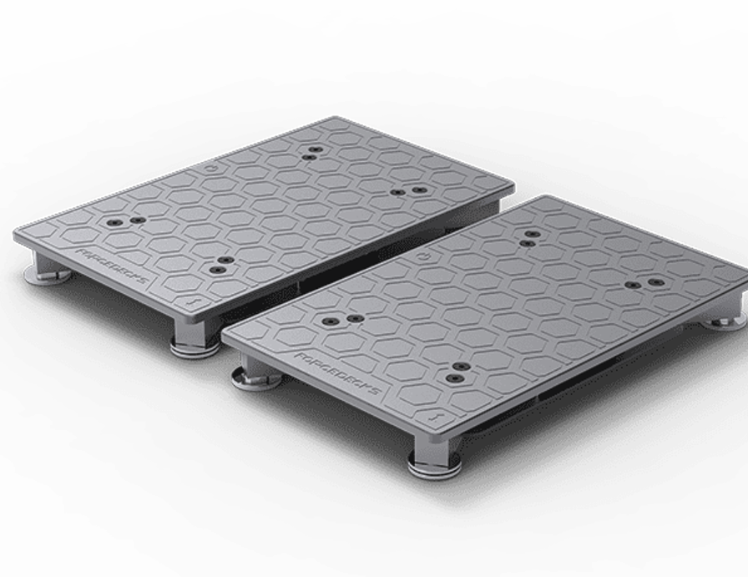
Background
Peak power output (PPO) greatest production of work over timeframe⁸
Represents balance between force velocity balance
Modified Reactive Strength Index (RSImod) normalizes jump height by contraction time from start to takeoff²
RSImod = flight time / contraction time
Training adaptations and fatigue can impact PPO and RSImod ^{2-3, 8}
Notes:
Both metrics have potential to reflect how athletes are coping with training which is related to injury risk. Peak power is an isolated variable, while RSImod is two interacting, which we perceived to be a good starting point.
We used CMJ metrics obtained from force pate testing, as these metrics directly measure lower body abilities.

Slide 5
Methods
Literature Review
Metrics of interest
Descriptive Statistics
Team-by-team perspective
Correlation and Regression Analysis
Significance
Similar studies/questions
Defining variables
Global view
Inclusion and exclusion criteria
Injury type
Z-Scores
Injury Group
Mechanism
Significance of results
Differing Metrics
Notes:
Different Ways to Calculate Z-Scores
Injury Groups (Foot, Leg, …)
Peak Power vs RSI Modified
How we determined Significance
Some Limitations

Slide 6
Data cleaning and organization
Removed irrelevant injury report variables
Duplicate observations
Cheer and dance
"Illness" reports
Non-STI and above the trunk injuries
Assigned data to injury regions based on classifications
Matched injury reports to force plate data
Standardized athlete names as well as test and injury dates
Included injury observations that had jump testing trials
Average force plate trials for each testing day
Injury Groups (Foot, Leg, Pelvic, Midsection)
Notes:
Not Lower Body – Neck, Shoulder, Chest, Hand
Not Soft Tissue – Dislocation, Nerve, Fracture, etc.
Duplicate Observations by looking at all injury reports within a week by same athlete
No jumps for cheer
Need Jump within month of injury and another within 6 months

Slide 7

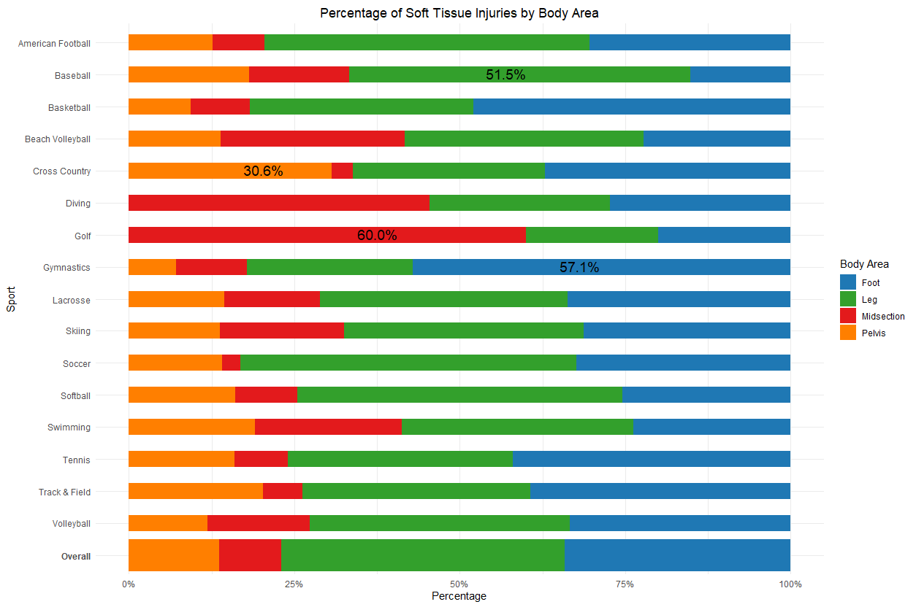
Notes:
Percent of soft tissue injury by regions , colors indicating body areas, are on the X axis. Individual sports on the Y., and overall distribution shown at the bottom.
Highest percentages of each area are labeled. Gymnastics had the greatest percentage of foot injuries, while golf had the greatest midsection percentage. Number of observations, which we'll speak to next, impacted how dramatic these appear.
Foot – Ankle, Foot
Leg – Lower Leg, Knee, Thigh
Pelvic – Buttock/Pelvis, Hip/Groin
Midsection – Trunk/Abdominal, Lumbar Spine

Slide 8
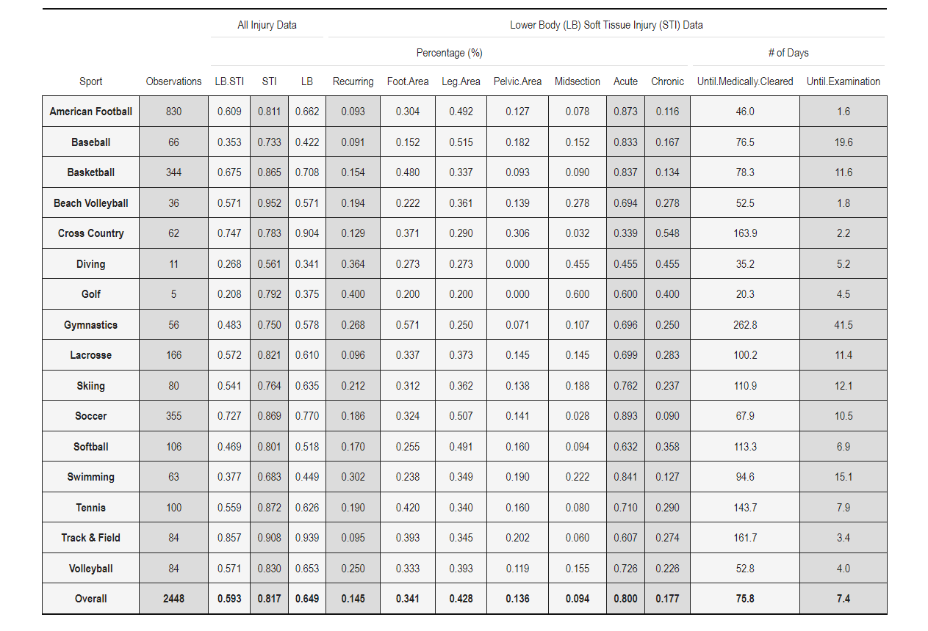
Notes:
Grouped by Highlighted Portions
Overview of two previous charts
Descriptive Statistics by Sport
LB STI is about 60% for our recorded injuries
Acute 80% overall
Recurring Low

Slide 9
Notes:
Keep in mind for rest of analysis
Golf and Diving have very low observation counts
We have Observations from 2020 – 2023

Slide 10
Notes:
Acute Injuries are much higher than chronic
Cross Country only one with lower acute

Slide 11
Relationship between Force Plate Metrics and lower body STI
Force Plate Metrics:
Peak Power / BM [W/kg]
RSI-modified [m/s]
6-month time frame (before injury occurrence)
Average of previous 5 months as reference (excluded most recent month to avoid mathematical coupling)⁴
Force plate trials completed a month before are compared to the acting average
Z-scores are how many standard deviations away from mean (5-month avg.)
Calculated by regression (trials with min max, manual calculation, etc.)
Charts are Averaged by 3-day periods
Reduces magnitude of Z-scores, but evens out trends
Notes:
Injury risk is elevated for a month following a substantial increase in fatigue
Speak on time frame
5-month average is similar to a season (gives a solid baseline)
Lots of variation without 3-day average
Regression Z-Scores gives us best significance/confidence in results

Slide 12
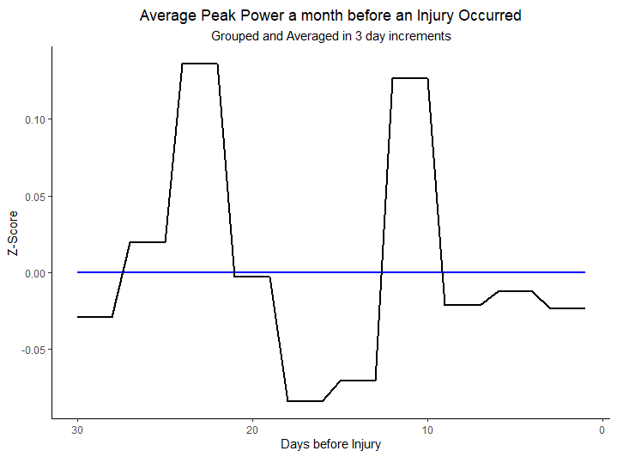
Peak Power
Low Z-score Magnitudes
Fluctuates over 0
Lacking insights
Great starting point
Notes:
Describe the Chart
Y-Axis, X-Axis, Flat Lines

Slide 13
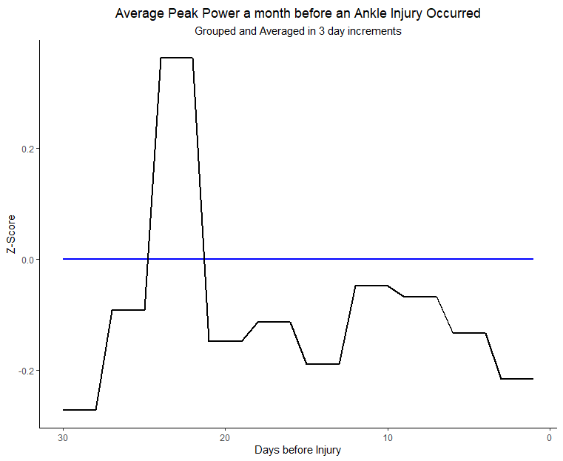
Peak Power by Ankle Injuries
Greater Z-score magnitudes
All but one period under 0
Adding a parameter provides more clarity
decrease in peak power pre-injury

Slide 14
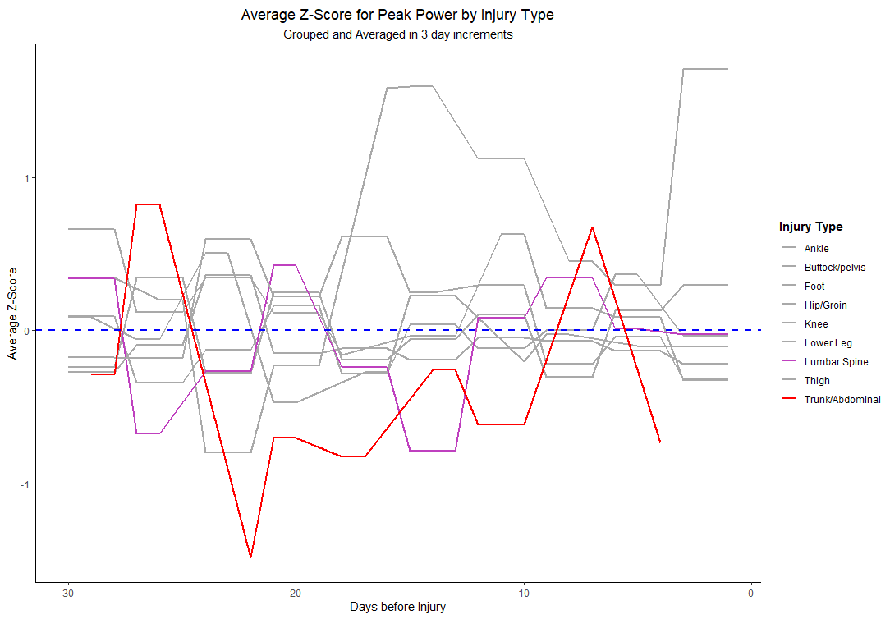
Peak Power by injury group
Z-Score magnitudes continue to increase
Ankle, Lumbar, and trunk are mostly negative
Peaks related to low observations
Notes:
Did not highlight Ankle because it was previous chart
9 Injury Types Charted
Keep highlighted metrics in mind

Slide 15
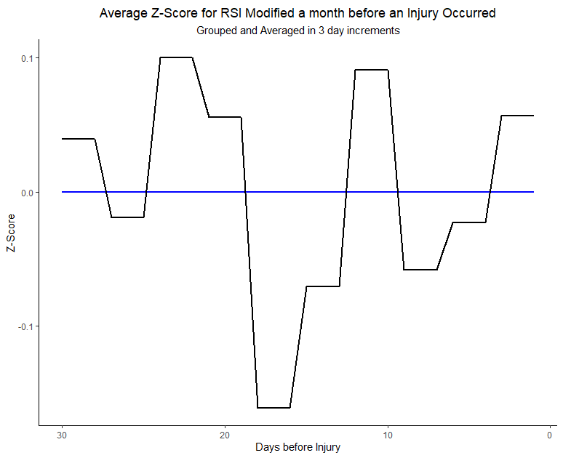
RSI Modified
Fluctuates over 0
Lacking insights
Greater magnitudes compared to peak power
Notes:
RSI has multiple metrics included
Make the connection between that and selecting ankle injuries

Slide 16
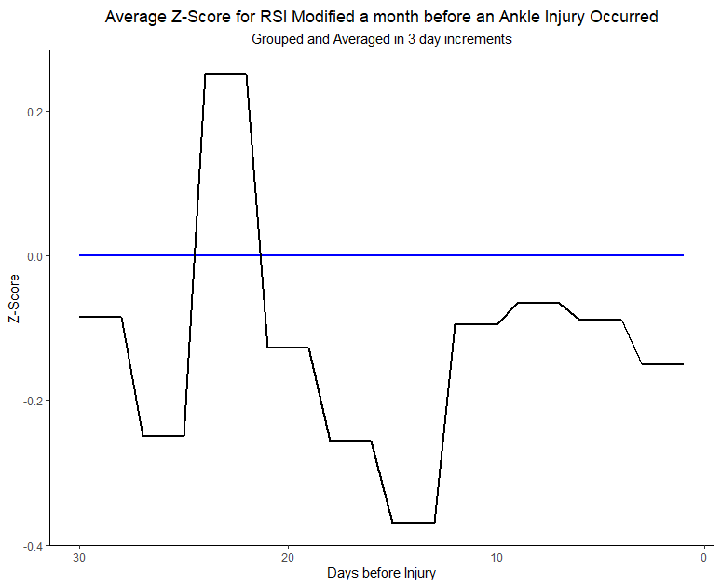
RSI Modified by Ankle Injury
Comparable to peak power by ankle
Slight increase in Z-score Magnitudes
All but one period under 0
Adding parameter once again provides clarity
decrease in RSImod pre-injury

Slide 17
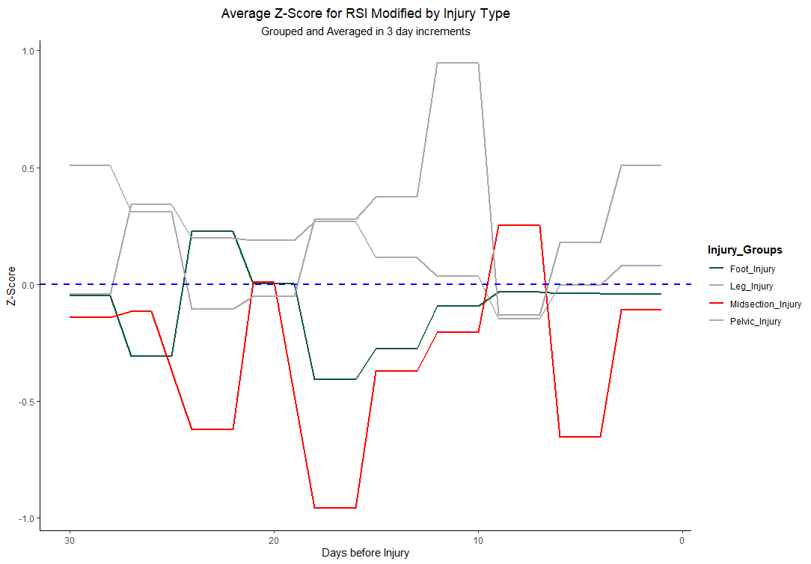
RSI Modified by injury group
Large z-score magnitudes
Injury Significance
Midsection: Avg of - 0.25 SD below the Mean
Foot: Avg of - 0.10 SD below the Mean
SD ≈ 0.05 change in RSImod
Mirrors peak power by ankle and midsection injuries indicating negative trends
Notes:
Foot – Ankle and Foot
Midsection – Trunk/Abdominal and Lumbar Spine
Talk about the chart and how the lines dip, etc.

Slide 18
Findings & Significance
Being consistently below the average in a month can indicate injury danger
Regression used to calculate Z-score has R-squared of .8294 (Look for above .50)
Regression = month before injury regressed on 5-month average and time between injury and test
5-month average was statistically significant in predicting RSImod on test dates. Shows we can use this as a baseline and work off of that

Slide 19
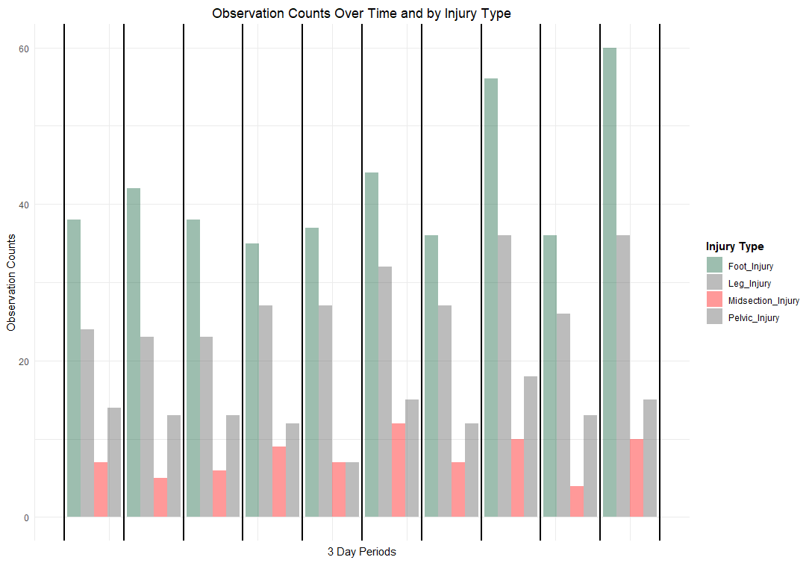
Data limitations
Observations for grouped times
Foot injuries have 3-4x greater observations compared to other injury types
Less confident in midsection results compared to foot injuries
Notes:
As we have mentioned throughout….
Avg about 40 for Foot
Less than 10 for Midsection

Slide 20
Considerations
variations in pain tolerance and support
recall and inconsistent reporting procedures
Statistical vs practical Significance
Notes:
Pain tolerance and likelihood to seek support vary from athlete to athlete.
Injury records are susceptible to recall bias, alongside the inconsistent reporting patterns that we observed.
Statistical significance in our current findings are likely related to sample size, understanding how this is related to practical significance, or minimally important change, is essential when making decisions.

Slide 21
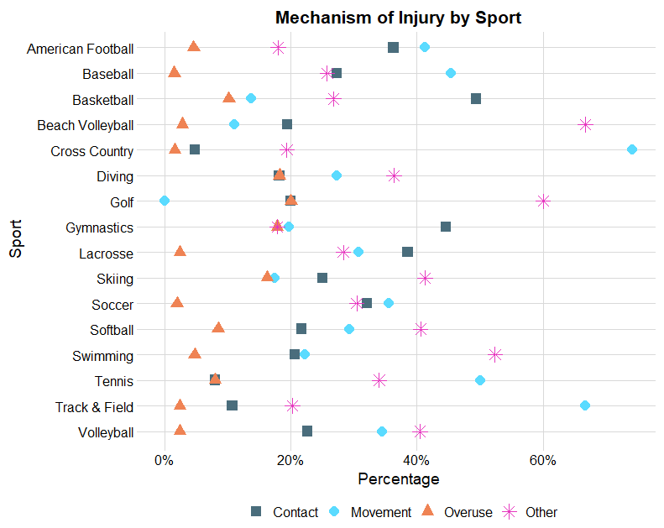
Injury Mechanism
Mechanism helps explain what contributed to mechanical overload¹
^{Movement}
Jump, Run, Acceleration, Change of Direction
^{Contact}
With Ground, Tackled, Fall, Landing, With Playing Device
^{Overuse}
^{Overload, Repetitive Trauma}
^{Other}
Unknown, Misc., Other, No specifics
Notes:
Began looking at injury mechanisms within each sport. Mechanism helps us understand what contributed to tissue overload and subsequent injury.
Percentage of mechanism on X and sport on Y
Each shape represents mechanism recorded in reports
Cross country = movement, while basketball = contact
Yet, the high occurrence of "other" reflects missing information/lack of reporting consistency within reports

Slide 22
Future Directions
Explore additional jump metrics considering sensitivity and confounding
Rate of force development ^{6, 9}
Time constrained (force at zero velocity, time to peak power)⁶⁻⁷
Isolate components of RSImod (eccentric vs concentric contraction)^{3, 6-7}
Recurring injuries and asymmetries
Notes:
Current results indicate that RSImod and Peak Power may be inappropriate for monitoring fatigue and injury risk across all athletes for all injury groups. Determining it's appropriateness for specific-contexts is challenging to determine with the number of observations we have.
Moving forward – explore time constrained variables and components of RSImod considering sensitivity to detect change, alongside the influence of recurrent injuries and limb asymmetries on relationships.

Slide 23
References
Bahr, R., & Krosshaug, T. (2005). Understanding injury mechanisms: a key component of preventing injuries in sport. British journal of sports medicine, 39(6), 324–329. https://doi.org/10.1136/bjsm.2005.018341
Barker, L. A., Harry, J. R., & Mercer, J. A. (2018). Relationships between countermovement jump ground reaction forces and jump height, reactive strength index, and jump time. Journal of Strength and Conditioning Research, 32(1), 248. https://doi.org/10.1519/JSC.0000000000002160
Cormie, P., McBride, J. M., & McCaulley, G. O. (2009). Power-time, force-time, and velocity-time curve analysis of the countermovement jump: impact of training. Journal of strength and conditioning research, 23(1), 177–186. https://doi.org/10.1519/JSC.0b013e3181889324
Edwards, T., Spiteri, T., Piggott, B., Haff, G. G., & Joyce, C. (2018). A Narrative Review of the Physical Demands and Injury Incidence in American Football: Application of Current Knowledge and Practices in Workload Management. Sports medicine (Auckland, N.Z.), 48(1), 45–55. https://doi.org/10.1007/s40279-017-0783-2
Fuller CW, Ekstrand J, Junge A, et al. Consensus statement on injury definitions and data collection procedures in studies of football (soccer) injuries. Scand J Med Sci Sports. 2006;16:83-92. https://doi.org/10.1111/j.1600-0838.2006.00528.x
Gathercole, R., Sporer, B., Stellingwerff, T., & Sleivert, G. (2015). Alternative countermovement-jump analysis to quantify acute neuromuscular fatigue. International journal of sports physiology and performance, 10(1), 84–92. https://doi.org/10.1123/ijspp.2013-0413
Harry, J. R., Paquette, M. R., Schilling, B. K., Barker, L. A., James, C. R., & Dufek, J. S. (2018). Kinetic and Electromyographic Subphase Characteristics With Relation to Countermovement Vertical Jump Performance. Journal of applied biomechanics, 34(4), 291–297. https://doi.org/10.1123/jab.2017-0305
Komi, P. (2008). Strength and power in sport, ed. P. Komi. Vol. 3.
Maffiuletti, N. A., Aagaard, P., Blazevich, A. J., Folland, J., Tillin, N., & Duchateau, J. (2016). Rate of force development: physiological and methodological considerations. European journal of applied physiology, 116(6), 1091–1116. https://doi.org/10.1007/s00421-016-3346-6
Rebekah L Lawrence, Paula M Ludewig, Samuel R Ward, An Integrated Approach to Musculoskeletal Performance, Disease, and Recovery, Physical Therapy, Volume 101, Issue 12, December 2021, pzab225, https://doi.org/10.1093/ptj/pzab225
Romero-Morales, C., López-López, D., Almazán-Polo, J., Mogedano-Cruz, S., Sosa-Reina, M. D., García-Pérez-de-Sevilla, G., Martín-Pérez, S., & González-de-la-Flor, Á. (2023). Prevalence, diagnosis and management of musculoskeletal disorders in elite athletes: A mini-review. Disease-a-month : DM, 101629. Advance online publication. https://doi.org/10.1016/j.disamonth.2023.101629

